Slide 1
Data visualisation WhereWeMove

Slide 2
RQ2: What behavioural patterns emerge in housing & flood protection choices based on players welfare types in the WhereWeMove game?
Game settings
GS1: What type of houses are available every round?
GS2: What is the player's budget and expectations?
GS3: Which measures costs and effects?
GS4: How is risk perception assessed?
GS5: Which news apply every round?
Gameplay
GP1: Where do players prefer to live?
GP2: How did players spend their money?
GP3: Which measures do players choose in the game?
GP4: How was the flood experience in the game?
GP5: How do damage and satisfaction changes influence choices?

Slide 3
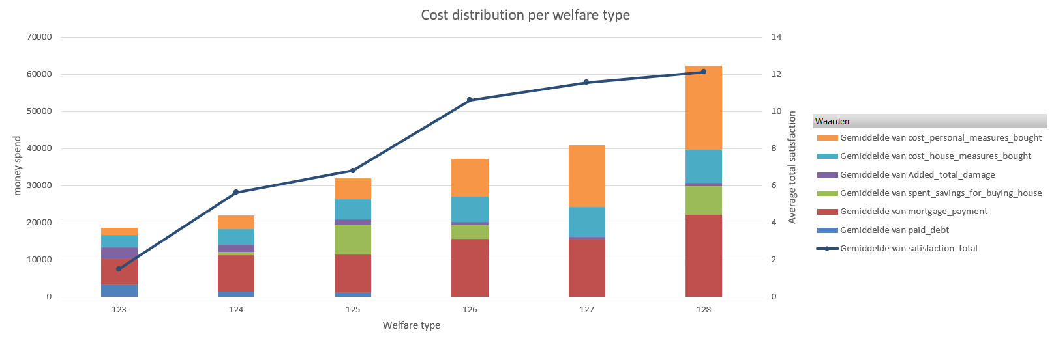
Cost distribution per welfare type
This chart shows how total costs are distributed across different welfare types and which cost categories are influencing those totals. The line adds an extra layer by showing how satisfaction changes alongside spending. This makes it easy to compare groups and spot patterns.

Slide 4
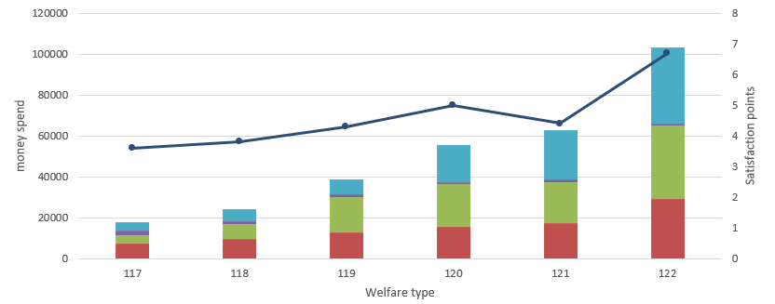
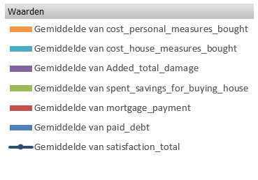
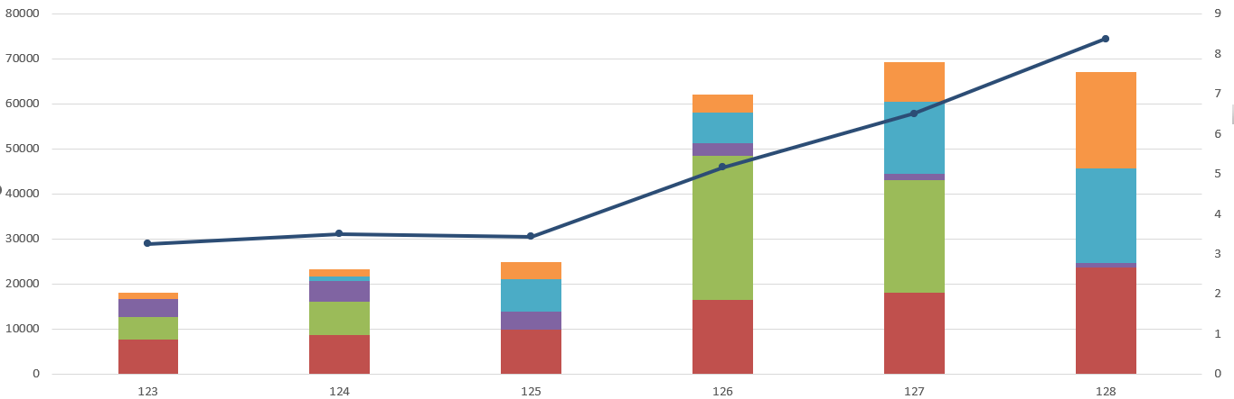
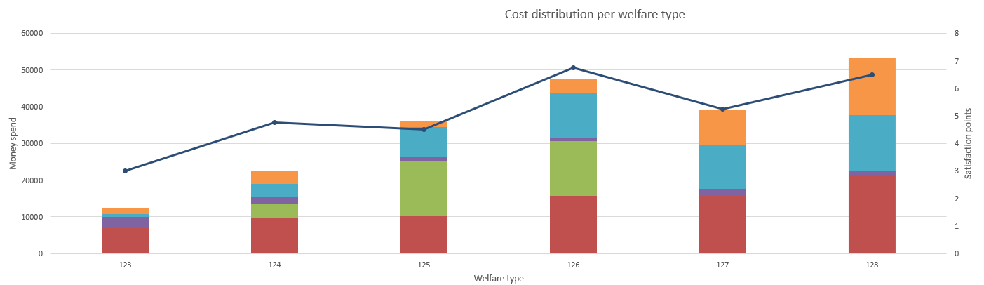
Round 1
For all sessions

Slide 5
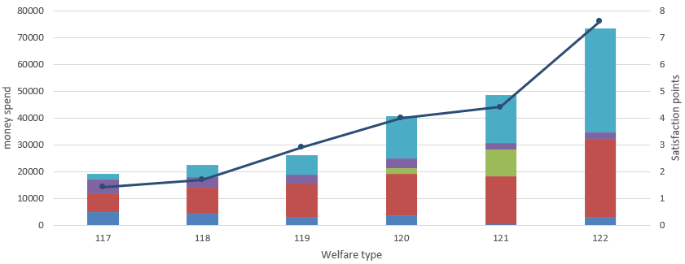
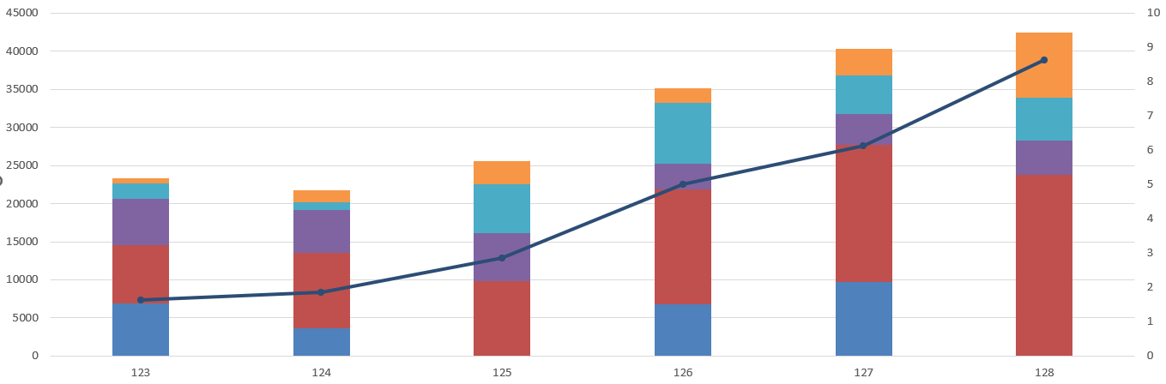
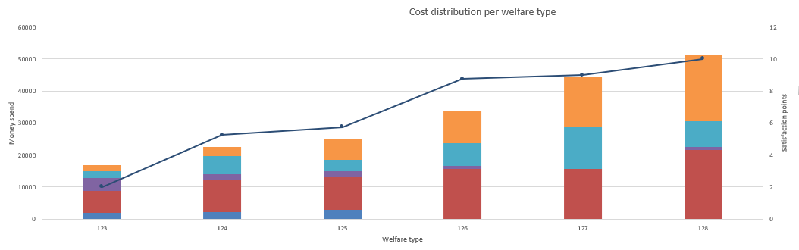
Round 2
For all sessions

Slide 6
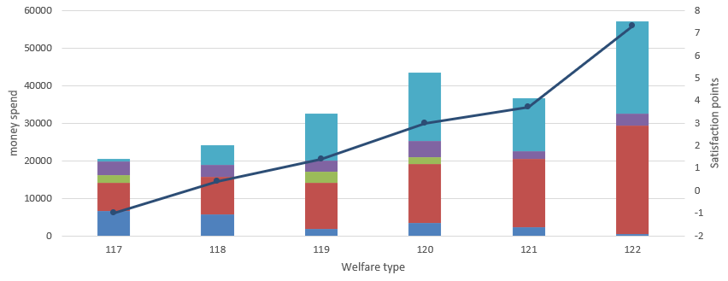
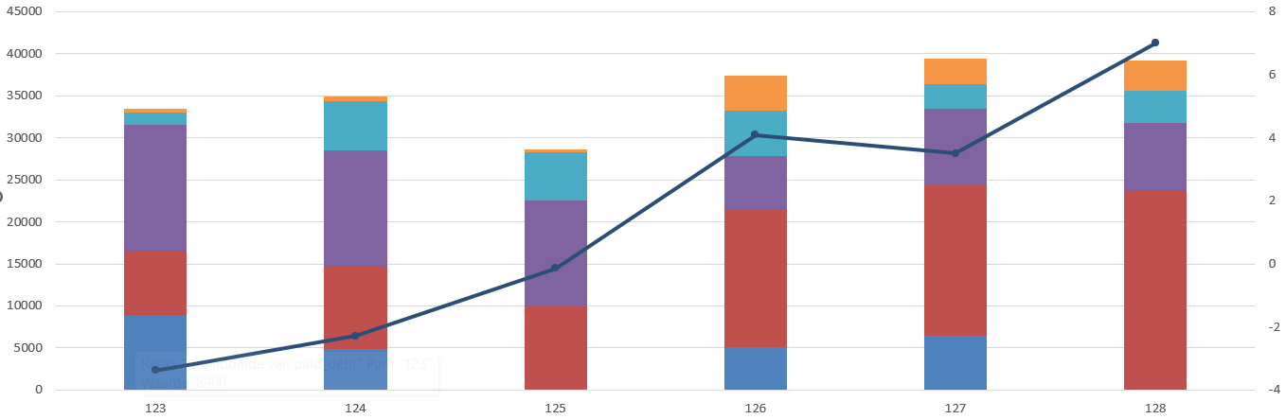
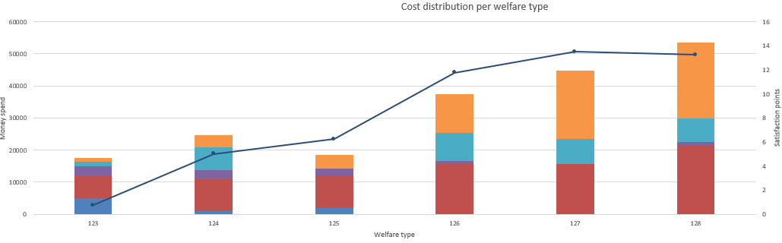
Round 3
For all sessions

Slide 7
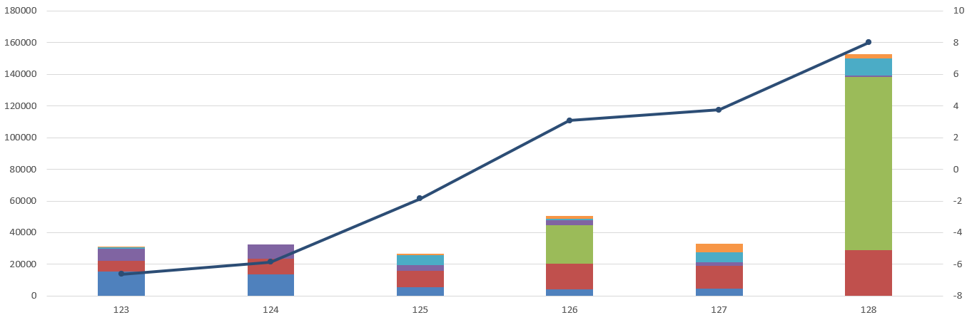
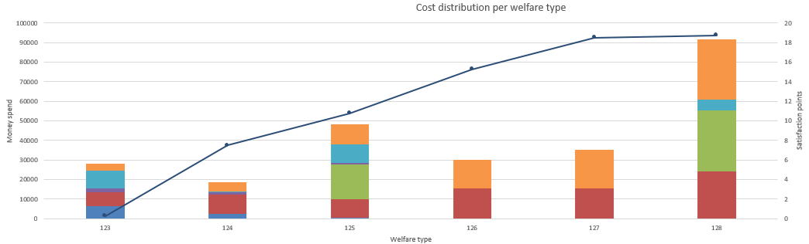
Round 4
For two sessions

Slide 8
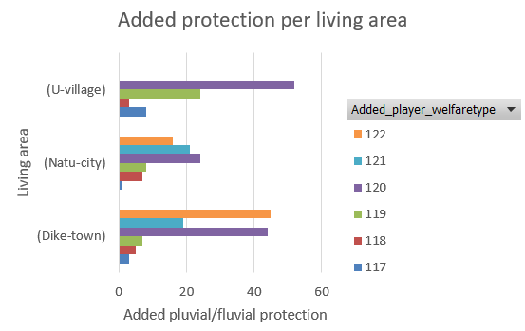
Impact of welfare type on added housing protection per living area
This chart shows how different welfare types contribute to housing across the three living area’s. It helps you see which welfare group invests the most in each place and whether certain environments trigger higher improvements. This makes it easy to spot patterns, compare groups, and identify which locations benefit the most.

Slide 9
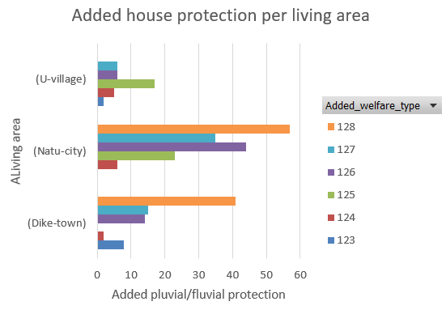
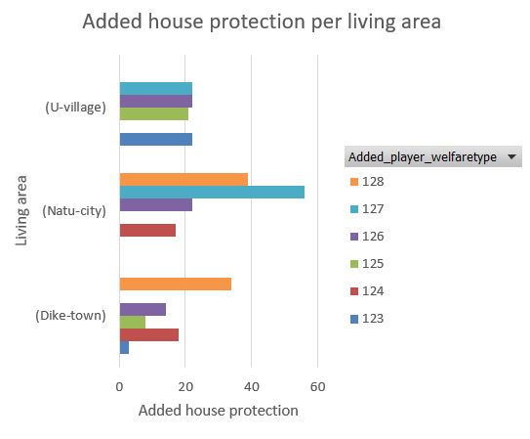
Added protection per living
area during the whole game.
For all 3 sessions

Slide 10
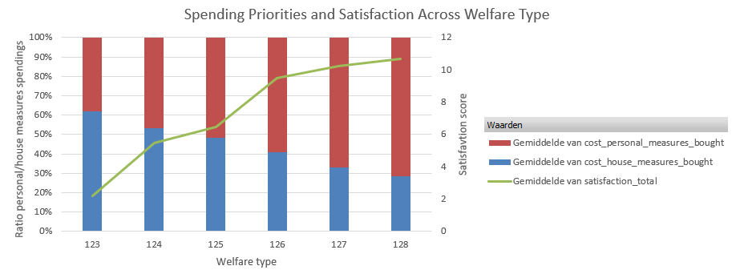
Spending priorities and satisfaction across welfare types
This chart shows how each welfare type divides its spending between house measures and personal measures, and how that relates to their average satisfaction. It lets you quickly see whether groups that invest more in personal measures, or more in house measures, end up being more satisfied. This makes it easy to compare strategies and spot a possible link between spending choices and outcomes.

Slide 11
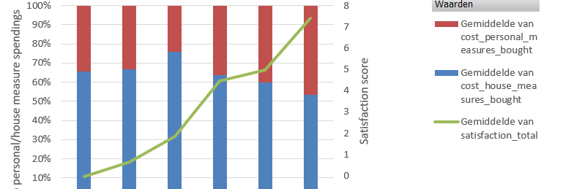
Spending priorities and satisfaction across welfare types, average of allr rounds
For 2 sessionms

Slide 12
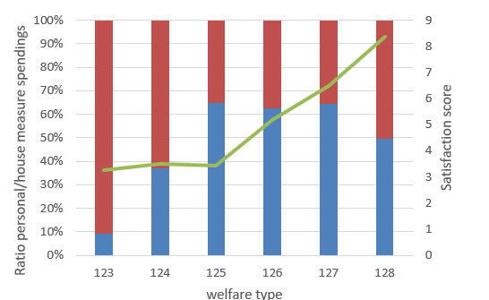
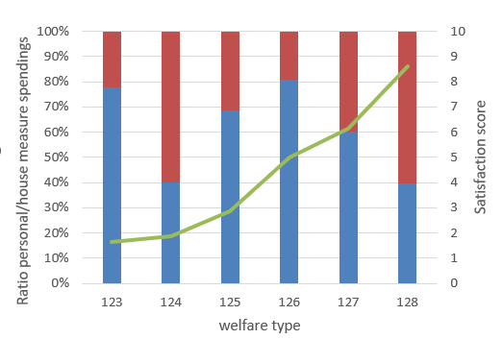
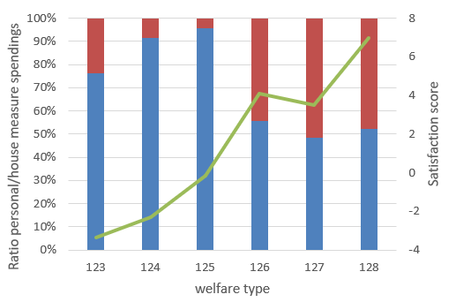
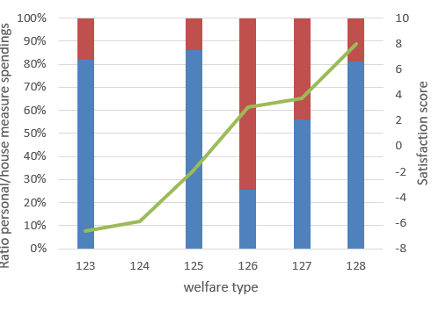
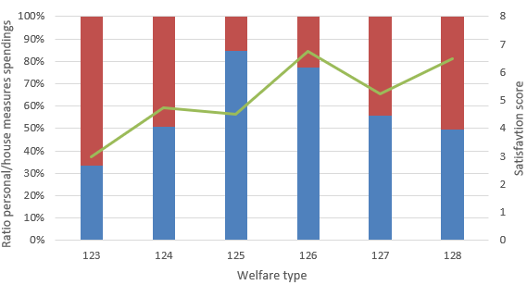
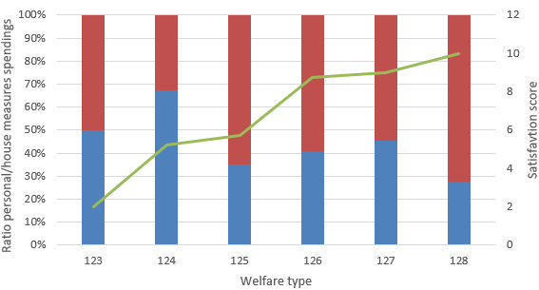
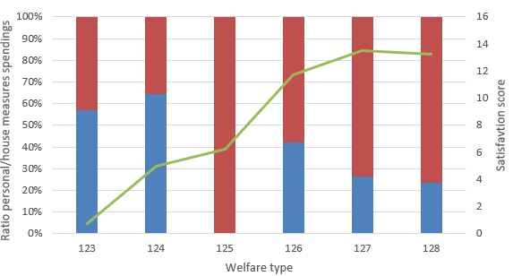
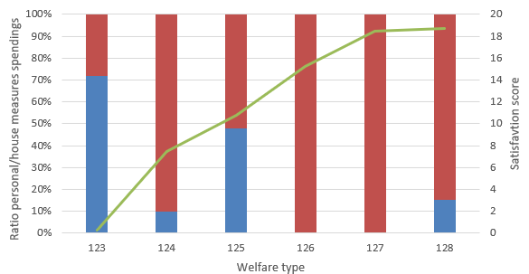
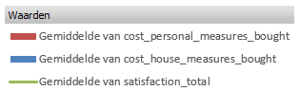

Slide 13
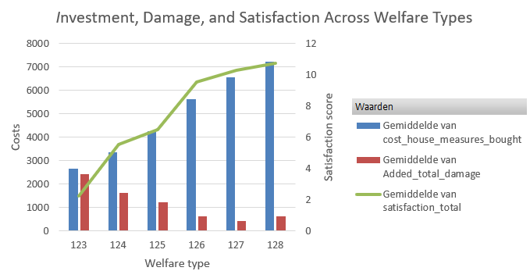
Investment, damage, and satisfaction across welfare types
This plot is useful because it shows how spending, damage, and satisfaction are connected across welfare types. You can easily see that higher-welfare groups spend more, experience less damage, and end up more satisfied. This makes it a clear tool for comparing groups and judging whether investments are effective.

Slide 14
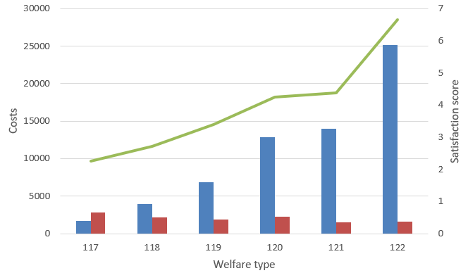
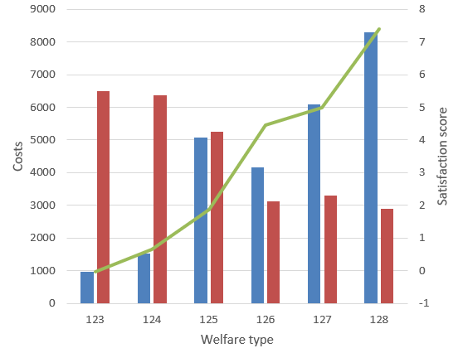
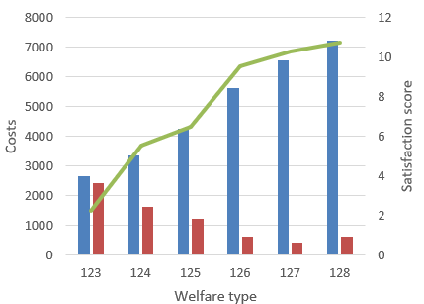
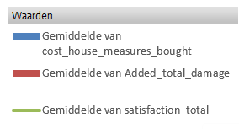
Average of all rounds for each session

